Slide 1
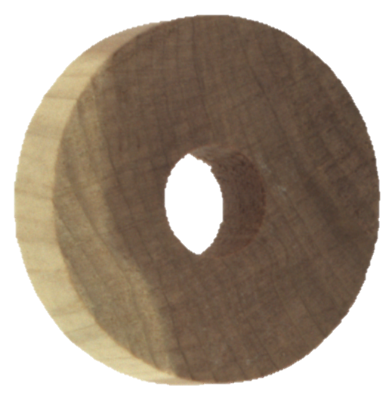
Industrial anomaly detection of wood texture using unsupervised learning for quality assessment process automation
By
Chaitanya

Slide 2
Overall Content
1
Solution Overview and EDA Report
2
Data Cleaning and Preparation
3
Feature Engineering
4
Isolation Forest Model Development & Evaluation
5
Autoencoders Model Development & Evaluation
6
Model Performance Report
7
References

Slide 3
Overall Content
1
Solution Overview and EDA Report
2
Data Cleaning and Preparation
3
Feature Engineering
4
Isolation Forest Model Development & Evaluation
5
Autoencoders Model Development & Evaluation
6
Model Performance Report
7
References

Slide 4
Solution Overview
Accurate and swift quality inspection is very essential for meeting planned demand as well as maintaining good customer satisfaction scores in any manufacturing industry.
Project Scope: For current the project purpose we will be using images of manufactured wooden objects for training unsupervised models to identify possible defects in the object’s texture
Growing human resource cost is also one of the major factors which signals business to move out of traditional manual QA to automated one.
As occurrence of defects/anomalies is a rare instance hence less data to train models, this makes modeling anomalies very difficult
This problem of anomaly detection under the presence of low or no tagged data needs unsupervised machine learning and deep learning techniques instead of traditional classification based models
Majority of the industries deploys workers for manual identification of product defects
Though manual QA is works well for minor industrial units, heavy manufacturing industries which mass produces physical goods needs autonomous system for manufacturing as well as quality inspection
Manual inspection will not only slow down the manufacturing process but also has serious impact business operating cost
What
Why

Slide 5
Data Source, Procurement and Details
Data Source: Kaggle.com (Orginally shared by ITI-Instituto Tecnológico de Informática)
Source Description: Following is the source description as per Wiki “Kaggle, a subsidiary of Google LLC, is an online community of data scientists and machine learning practitioners. Kaggle allows users to find and publish data sets, explore and build models”
Method of Procurement: Direct download from Kaggle.com
Data Context: Data consists of set images belonging to an wooden objected manufactured post industrial operations. Images belong to a single product with looks like a wheel. Data provided has images for both good and faulty wooden objects under different folders. As the idea of the current project is to us unsupervised techniques for anomaly detection we will be using only images under “train” and “validation” folders (which only contains images of object without defects) and “test” (which only contains images of object with defects) for evaluation of unsupervised model developed.
Source Link: https://www.kaggle.com/datasets/itiresearch/wood-anomaly-detection-one-class-classification

Slide 6
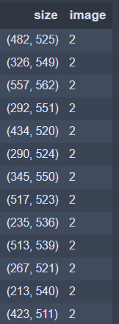
EDA Details and Insights
Total # of Non-Anomalous Images (Train):
Total # of Anomalous Images (Test):
Total # of Unique Image Sizes:
953
327
1,257 out of 1,280
Key Insights:
Table 1: Table showing a sample of images size and corresponding count of images
As its observed from the initial EDA that data extracted has only 953 image which is a bit less from ML/DL models to learn
To address this data quantity issue image rotation technique can be used for increasing data volumes for training
We have 1,257 unique image dimensions out of 1,280 images this shows that as part of pre-processing we need to resize the images before we start model development

Slide 7
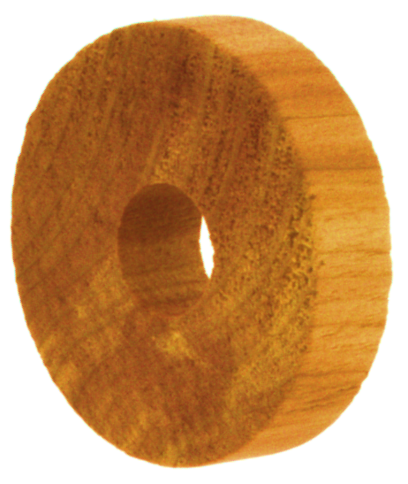
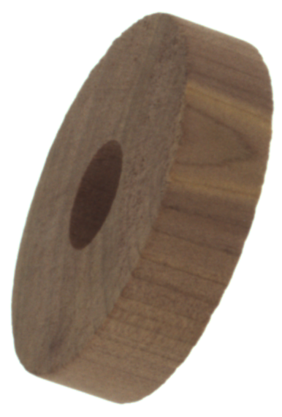
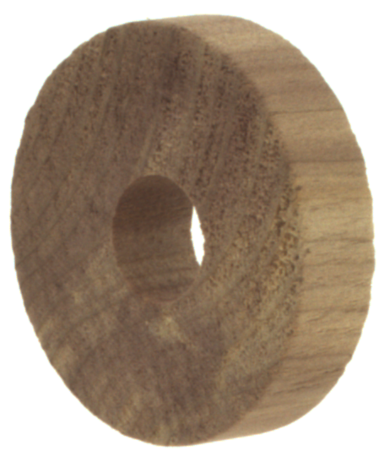
Sample Anomalous vs. Non-Anomalous Images
Non-Anomalous Image
Anomalous Image
Irregularities on the surface of wooden object
Key Observations:
Based on initial observation of the images, anomalies on the wooden object are majorly observed due to irregularities on the image while a proper object is expected to be smooth

Slide 8
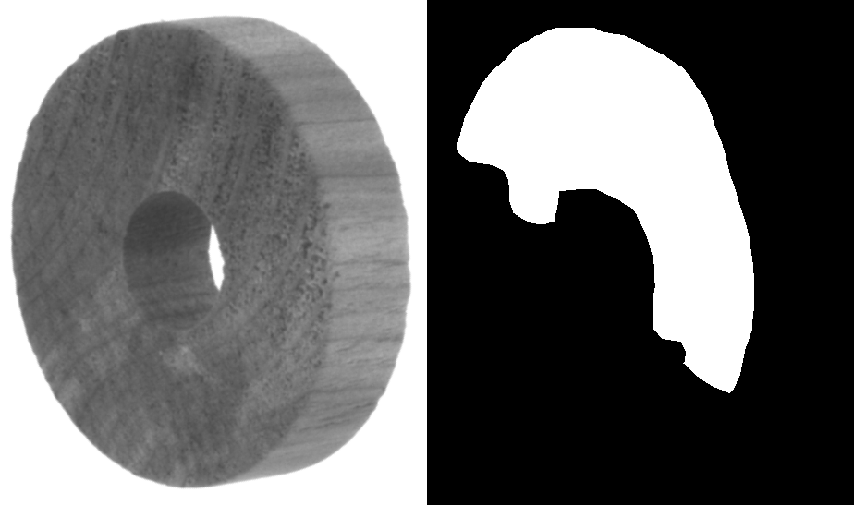
Understanding an Anomalous Object
Area with Irregularities
Anomalous Wooden Obj. (Coloured)
Non-Anomalous Wooden Obj. (B&W)
Non-Anomalous Wooden Obj. (Masked)
Key Observations:
Anomalies on the wooden object are majorly observed due to irregularities on the image
Rough surfaces on the wooden object has been to be identified by machine learning model developed. This can be challenging as irregularities are appearing similar to the colour patterns on the surface

Slide 9
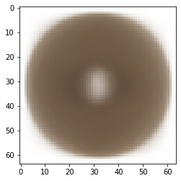
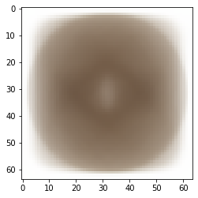
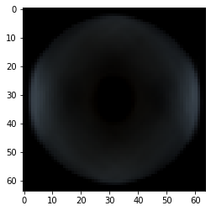
Do we observe any significant differences in an anomaly vs non-anomaly object?
Idea: A general idea differences between on all anomalous vs non-anomalous images can be identified by observed an “Average Image” or “Variance Image”. An average image is an image obtained by averaging pixel values of individual images similar a variance image is an image obtained by calculating standard deviation of pixel value of individual images.
Average Image of Anomalous Objects
Average of Non-Anomalous Objects
Difference Image
Key Observations:
Average image didn’t provide much information on anomaly vs non-anomaly due the data issue i.e., we have image with different dimension as well as rotations which in turn is causing issues for comparison

Slide 10
Eda Conclusion and Next Steps
Though in the initial EDA it was found that the data size is relatively smaller, image rotation can be used for generating additional datapoint to model
Anomalies observed on the wooden object are majorly due to irregularities (peak and valleys instead of smooth surfaces) and in majority of the cases it matches with the color patterns on the wood. This might make anomaly identification a bit complicated
We have 1,257 unique image dimensions out of 1,280 images this shows that as part of pre-processing we need to resize the images before we start model development
Next Steps
Data pre-processing based on EDA observations
Model Development

Slide 11
Overall Content
1
Solution Overview and EDA Report
2
Data Cleaning and Preparation
3
Feature Engineering
4
Isolation Forest Model Development & Evaluation
5
Autoencoders Model Development & Evaluation
6
Model Performance Report
7
References

Slide 12
Making Image Sizes Consistent
Through in the initial EDA it was found that the data size is relatively smaller, image rotation can be used for generating additional datapoint to model (Refer to the table)
Each pixel of image will be treated as feature/column in a table for modeling. It is essential to have all the images in training and test dataset to have same size for easy modeling
Image rescaling to small size also helps in reducing the number feature there by reducing model runtime
In current project we have resized all image to 60x60 initially. This can later be changed based on model performance.
Table 1: Table showing a sample of images size and corresponding count of images

Slide 13

Image to Pixel Array Conversion
RGB values are extracted from colored resized images
Extracted RGB values are stacked together to from a single 1D array of RGB values
Above process is followed for each image and final base table for model processing has been created
Original Image
 |  |  |  |  |  |  |  |  |  |  | ….
 |  |  |  |  |  |  |  |  |  |  | ….
 |  |  |  |  |  |  |  |  |  |  | ….
Table 1: Image to RGB conversion. Then to 1D Array

Slide 14



Addressing data quantity/size issue
Training data extracted from the source only has ~950 images for training which is relatively lower for training a good machine learning models. To address this problem we will be using image rotation technique where an image will be rotated around the median by a specified angle. In the current project we are apply three rotation to original image there by generating 3x additional data for modeling.
We have applied rotation by 90°, 180° and 270° for each original image which helped us in increasing the training data size from ~950 images to ~3800 images.
Image Rotated by 90°
Image Rotated by 270°
Original Image
Image Rotated by 180°

Slide 15
Overall Content
1
Solution Overview and EDA Report
2
Data Cleaning and Preparation
3
Feature Engineering
4
Isolation Forest Model Development & Evaluation
5
Autoencoders Model Development & Evaluation
6
Model Performance Report
7
References

Slide 16
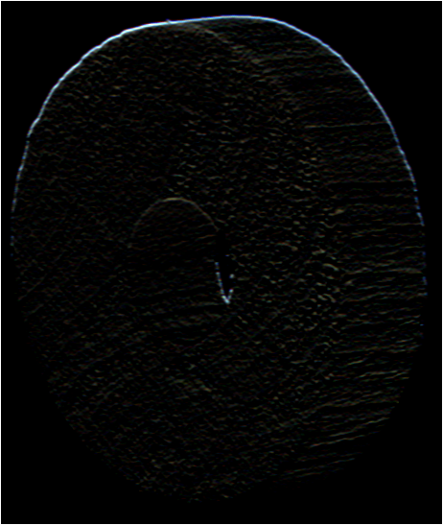
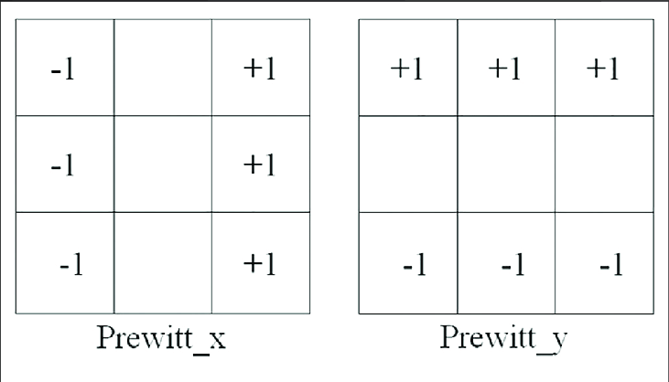
Object Edge Extraction
Prewitt kernel:
Edge Extraction using Prewitt Kernel:
Original Image
Edges Extracted
Building model on edge extracted images helps in
Reducing the noise in images there by improving modelling accuracies
Edge extracted images also helps in dimensionality reduction as image gets converted into grey scale
Prewitt Kernel has been used for edge extraction and these edge extracted image will be used for model development

Slide 17
Image Pixel Scaling
Original Image RGB Value
Scaled Image RGB Value
Large feature values will results in unstable deep learning models due to large weights
To avoid this problem of unstable models and to make model process faster we are scaling input features using min max scaler i.e., dividing by 255
Scaled image pixel will be used for final model development

Slide 18
Overall Content
1
Solution Overview and EDA Report
2
Data Cleaning and Preparation
3
Feature Engineering
4
Isolation Forest Model Development & Evaluation
5
Autoencoders Model Development & Evaluation
6
Model Performance Report
7
References

Slide 19

Isolation Forest – Results Deep Dive (Parameter Tuning)
As reported in proposal unsupervised isolation forest model has been developed and tuned on Number of Estimators, Contamination rate and Max Features parameters. Following are the high-level results and observations
Number of Estimators: Model Exhibited best accuracy at low (<20) and higher number (>71) of estimators. Number of estimators = 91 is considered as best value due high accuracy (~4.5%) and low complexity (less model iterations)
Contamination Rate: Model’s capability to increase anomalies on out sample test data is increasing with increase in contamination rate. But this is not desirable as the increase in contamination rate will increase False positive drastically. Due to this reason Contamination rate of 0.1 is selected as balance threshold
Max Features: Model exhibited mixed performance with change in number of features. At number of features 1700 (with best # Estimators & Contamination Rate) best model accuracy has been observed with a value of ~13%
At Contamination Rate 0.1 & Max Features 100
At Number of Estimators 91 & Max Features 100
At Number of Estimators 91 & Contim. Rate 0.1

Slide 20

Isolation Forest – Summary
Model: Isolation Forest
Initial Model Parameters:
Accuracy in Predicting Anomalous Images:
Only 54 out of 1308 Anomalous (Test Data, 4.5%) have been identified by the initial model
Summary
Current model accuracy is based on test data with only Anomalous images which might not account for model performance on false positives
Contamination parameter is being explored randomly as we don’t have any estimate on extent of anomalies in the data
Though model doing will in predicting positive class at higher contamination rates but increasing contamination rate is not desirable due to high false positive rates
Isolation forest might not be performing well due (best accuracy of 12.99% on test data) to high dimensionally use of one class neural networks might help in improving overall prediction accuracy
* Note that model has been trained only on Non-Anomalous images (One class approach)

Slide 21
Overall Content
1
Solution Overview and EDA Report
2
Data Cleaning and Preparation
3
Feature Engineering
4
Isolation Forest Model Development & Evaluation
5
Autoencoders Model Development & Evaluation
6
Model Performance Report
7
References

Slide 22
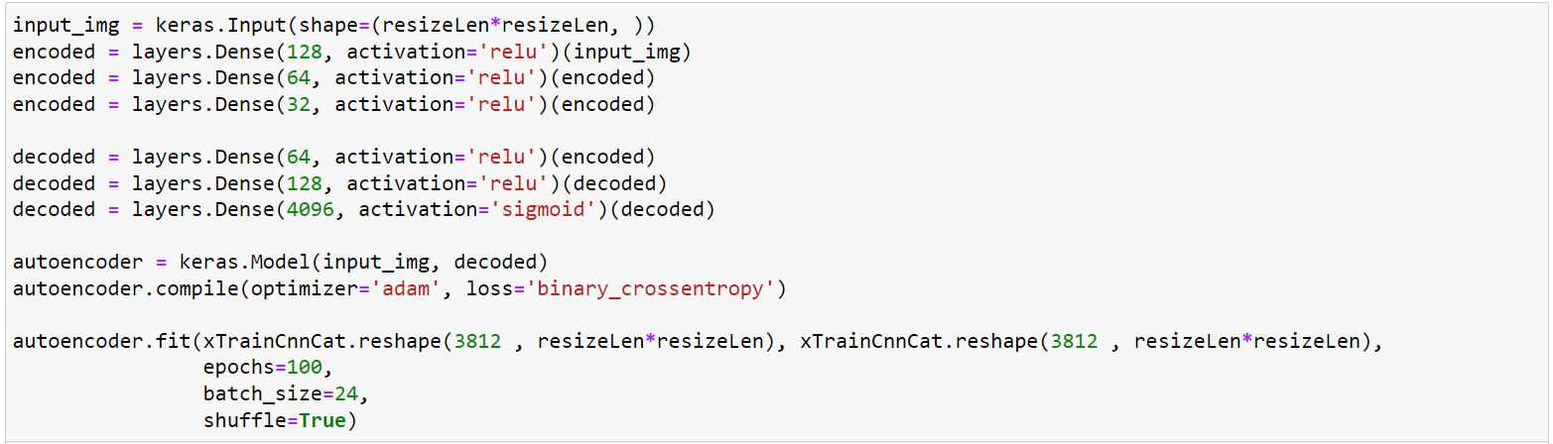
Autoencoder – Summary
Model: CNN Autoencoders
Initial Model Parameters:
Autoencoder vs Isolation Forest:
Autoencoders outperformed isolation forest in identifying anomalous images
Best autoencoder model could identify ~50% of anomalous images with 16% False Positive (FP) rate while isolation forest could identify only 13% of anomalous images at 10% Train FP rate
Based on this auto-endcorder have been selected as final model for predicting anomalous objects
* Note that model has been trained only on Non-Anomalous images (One class approach)

Slide 23
Autoencoder – Parameter Tuning Report
Developed CNN Autoencoder are trained and test for
By varying model architecture (units and depth)
Data Treatment
Varying images sizes (64*64 and 128*128)
Varying Edge Detection techniques (Prewitt and Canny Edge Detection)
Varying learning rate and Epochs
Fined tuned 128*128 resized image data with Canny edge detection exhibited best performance in comparison with others. This model has be selected as final model for anomaly detection

Slide 24
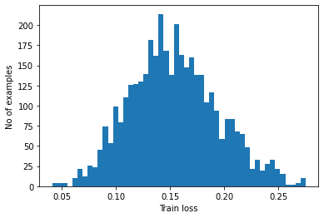
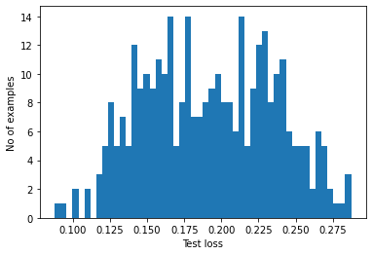
Autoencoder – Bias Report for Best Model Iteration
* Loss threshold = np.mean(train_loss) + alpha*(np.std(train_loss))
As we increase threshold value on train loss for classifying anomaly vs non-anomaly test accuracy is increasing while train accuracy is decreasing (refer to chart above
Based on afore mentioned observation threshold on train error is set in such a way so the we don’t observed a lot of false positive predictions
Best model with variance bias trade is observed at an alpha value of 34% (i.e., an observation is anomaly if prediction loss is > Mean Loss + 0.34 (Standard deviation of Loss)

Slide 25
Overall Content
1
Solution Overview and EDA Report
2
Data Cleaning and Preparation
3
Feature Engineering
4
Isolation Forest Model Development & Evaluation
5
Autoencoders Model Development & Evaluation
6
Model Performance Report – For best model
7
References

Slide 26
Autoencoder – Loss Metrics & Cost of ML Model for Best Model Iteration
Average Train Loss
Average Test Loss
Model Run Time
Model Evaluation Time
0.15
0.18
22 Min
16 Sec (for ~350 Entries)
Model Run Time per Epoch
45 Sec
* Loss function used Mean Squared Error

Slide 27
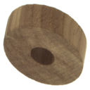

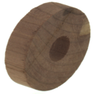

Autoencoder – Final Model Results
Train Metrics:
Sample Correctly Classified Anomaly
 |  | Count
 |  | Anomaly | Non-Anomaly
Train | Actual | - | 3,812
 | Predicted | 613 | 3,199
 |  | Precentage
 |  | Anomaly | Non-Anomaly
Train | Actual | 0% | 100%
 | Predicted | 16% | 84%
 |  | Count
 |  | Anomaly | Non-Anomaly
Test | Actual | 327 | 0
 | Predicted | 158 | 169
 |  | Precentage
 |  | Anomaly | Non-Anomaly
Test | Actual | 100% | 0%
 | Predicted | 48% | 52%
Test Metrics:
Sample In-Correctly Classified Anomaly
Very small irregulates on the edges which model couldn’t detect
“Based on observation of the object which were and weren’t identified by the model showed that objected with very few irregularities are not being detected. This behavior of the model can be address if model Is trained on larger dataset”

Slide 28
Autoencoder – Pre-Existing Model Research & Comparison
There are limited number of research papers available in the web for identifying anomalies in wooden patterns/textures. For instances “An Improved Wood Recognition Method Based on the One-Class Algorithm” by Jie He & Co. used VGG16 pre-trained model for identifying anomalies in wooden patterns and “Detecting Faulty Piles of Wood using Anomaly Detection Techniques” by Jonathan Olsson used f-AnoGAN and GAN for identifying anomalies in wooden patterns.
AS per the above papers average prediction accuracy for anomalous class was around 65% and in our current problem settings we could achieve an accuracy of ~50% which suggests that our model is doing satisfactorily doing well. Also we can compare these papers to our model exactly as dataset used for analysis are different. Since we had very few datapoints for model train we could not fully utilized the capabilities of deep learning.

Slide 29
Isolation Forest – Summary
Model: Isolation Forest
Initial Model Parameters:
Accuracy in Predicting Anomalous Images:
Only 54 out of 1308 Anomalous (Test Data, 4.5%) have been identified by the initial model
Summary
Current model accuracy is based on test data with only Anomalous images which might not account for model performance on false positives
Contamination parameter is being explored randomly as we don’t have any estimate on extent of anomalies in the data
Though model doing will in predicting positive class at higher contamination rates but increasing contamination rate is not desirable due to high false positive rates
Isolation forest might not be performing well due (best accuracy of 12.99% on test data) to high dimensionally use of one class neural networks might help in improving overall prediction accuracy
* Note that model has been trained only on Non-Anomalous images (One class approach)

Slide 30
Overall Content
1
Solution Overview and EDA Report
2
Data Cleaning and Preparation
3
Feature Engineering
4
Isolation Forest Model Development & Evaluation
5
Autoencoders Model Development & Evaluation
6
Model Performance Report
7
References

Slide 31
References
Reference: Image scaling and its importance in deep learning - Feature engineering
Description: https://www.linkedin.com/pulse/keras-image-preprocessing-scaling-pixels-training-adwin-jahn/
Reference: Image resizing and its impact on deep learning models
Description: https://link.springer.com/chapter/10.1007/978-3-030-95498-7_2
Reference: Use of image differencing for understanding variation between images
Description: https://en.wikipedia.org/wiki/Image_differencing
Reference: Object edge extraction techniques including Prewitt kernel
Description: https://sbme-tutorials.github.io/2018/cv/notes/4_week4.html
Reference: Data augmentation technique for deep learning
Description: https://www.v7labs.com/blog/data-augmentation-guide
Reference: Isolation forest for unsupervised anomaly dectection
Description: https://blog.paperspace.com/anomaly-detection-isolation-forest/

Slide 32
References
Reference: Research paper on the application of anomaly detection on wooden surfaces
Description: https://www.researchgate.net/publication/361974135_Applications_of_Deep_Learning_Techniques_to_Wood_Anomaly_Detection

Slide 33
Thank You

